Slide 1
Scheduling
Some of the slides are adapted from Matt Welsh’s.
Some slides are from Tanenbaum, Modern Operating Systems 3 e, (c) 2008 Prentice-Hall, Inc. All rights reserved. 0-13-6006639
Some slides are from Silberschatz, and Gagne.

Slide 2
Scheduling
Have already discussed context switching
Have not discussed how the OS decides which thread to run next
Context switching is the mechanism
Scheduling is the policy
Which thread to run next?
How long does it run for (granularity)?
How to ensure every thread gets a chance to run (fairness)?
How to prevent starvation?

Slide 3
Scheduler
The scheduler is the OS component that determines which thread to run next on the CPU
The scheduler operates on the ready queue
Why does it not deal with the waiting thread queues?
When does the scheduler run?

Slide 4
Scheduler
The scheduler is the OS component that determines which thread to run next on the CPU
The scheduler operates on the ready queue
Why does it not deal with the waiting thread queues?
When does the scheduler run?
When a thread voluntarily gives up the CPU (yield)‏
When a thread blocks on I/O, timer, etc.
When a thread exits
When a thread is preempted (e.g., due to timer interrupt)‏
Scheduling can be preemptive or non-preemptive
Preemptive: Timer interrupt can force context switch
Non-preemptive: Process must yield or block voluntarily
Batch vs. Interactive Scheduling
Batch: Non-preemptive and no other jobs run if they block
Interactive: Preemptive and other jobs do run if they block

Slide 5
Dispatcher
Dispatcher module gives control of the CPU to the process selected by the short-term scheduler; this involves:
switching context
switching to user mode
jumping to the proper location in the user program to restart that program
Dispatch latency – time it takes for the dispatcher to stop one process and start another running

Slide 6
Scheduling Policy Goals
Goal of a scheduling policy is to achieve some “optimal” allocation of CPU time in the system
According to some definition of “optimal”
Possible goals of the scheduling policy??

Slide 7
Scheduling criteria
Note: The term jobs (left from the early days of OS) can be replaced by ”processes”.
CPU utilization: The percentage of time that CPU is running (user) jobs
Throughput: The number of jobs completed per unit time
120 jobs completed over 1 minute:
Throughput: 2 jobs/second
Turnaround time: The duration from the submission of the job to its completion.
Job submitted at 8:05:00, and completed at 8:15:00.
Turnaround time: 10:00
Waiting time: The total amount of time a job spent in the ready list.
Load average: The average number of jobs in the ready queue.
Response time: The amount of time a request is submitted until the first response is produced.
The amount of time from pressing a key on the keyboard, and seeing it printed on the screen.

Slide 8
Scheduling Policy Goals
Possible goals:
Maximize CPU utilization ‏
Maximize throughput
Minimize turnaround time ‏
Minimize response time ‏
Minimize waiting time ‏
These goals often conflict!
Batch system: Try to maximize job throughput and minimize turnaround time
Interactive system: Minimize response time of interactive jobs (i.e., editors, etc.)‏
The choice of scheduling policy has a huge impact on performance

Slide 9
Starvation
Schedulers often try to eliminate thread starvation
e.g., If a high priority thread always gets to run before a low-priority thread
We say the low priority thread is starved
Not all schedulers have this as a goal!
Sometimes starvation is permitted in order to achieve other goals
Example: Real time systems
Some threads must run under a specific deadline
e.g., Motor-control task must run every 30 ms to effectively steer robot
In this case it is (sometimes) OK to starve other threads

Slide 10
First-Come-First-Served (FCFS)‏
Jobs are scheduled in the order that they arrive
Also called First-In-First-Out (FIFO)‏
Used only for batch scheduling
Implies that job runs to completion – never blocks or gets context switched out
Jobs treated equally, no starvation!
As long as jobs eventually complete, of course
What's wrong with FCFS?
Job A
Job B
Job C
time
Short jobs get stuck behind long ones!

Slide 11
Round Robin (RR)‏
Essentially FCFS with preemption
A thread runs until it blocks or its CPU quantum expires
How to determine the ideal CPU quantum?
Job A: 13 time units, Job B & C: 4 time units
Turnaround time with FCFS: Job A = 13, Job B = (13+4), Job C = (13 + 4 + 4)
Total turnaround time = 51, mean = (51/3) = 17
Turnaround time with RR: Job A = 21, Job B = 11, Job C = 12
Total turnaround time = 44, mean = (44/3) = 14.667
FCFS
Job A
Job B
Job C
time
RR
time

Slide 12
Shortest Job First (SJF)‏
Schedule job with the shortest expected CPU burst
Two broad classes of processes: CPU bound and I/O bound
CPU bound:
I/O bound:
Examples of each kind of process?
cpu
i/o
cpu
i/o
cpu
i/o
cpu
i/o
cpu
i/o
cpu
i/o
cpu

Slide 13
Shortest Job First (SJF)‏
Schedule job with the shortest expected CPU burst
Two broad classes of processes: CPU bound and I/O bound
CPU bound: e.g.compiler, number crunching, games.
I/O bound: e.g. web browser, database engine, word processor.
cpu
i/o
cpu
i/o
cpu
i/o
cpu
i/o
cpu
i/o
cpu
i/o
cpu
How to predict a process's CPU burst?
Can get a pretty good guess by looking at the past history of the job
Track the CPU burst each time a thread runs, track the average
CPU bound jobs will tend to have a long burst
I/O bound jobs will tend to have a short burst

Slide 14
SJF Example
Job A
cpu
i/o
Job B
cpu
i/o
Job C
cpu
i/o
Resulting schedule:
B
i/o
A
i/o
B
i/o
A
i/o
B is not on the ready queue!
C
i/o
B
i/o

Slide 15
Shortest Job First (SJF)‏
Schedule job with the shortest expected CPU burst
This policy is non-preemptive. Job will run until it blocks for I/O.
SJF scheduling prefers I/O bound processes. Why?
Idea: A long CPU burst “hogs” the CPU.
Running short-CPU-burst jobs first gets them done, and out of the way.
Allows their I/O to overlap with each other: more efficient use of the CPU
Interactive programs often have a short CPU burst: Good to run them first
To yield “snappy” interactive performance, e.g., for window system or shell.
We all do this. It is called “procrastination.”
When faced with too much work, easier to do the short tasks first, get them out of the way.
Leave the big, hard tasks for later.

Slide 16
Shortest Remaining Time First (SRTF)‏
SJF is a nonpreemptive policy.
Preemptive variant: Shortest Remaining Time First (SRTF)‏
If a job becomes runnable with a shorter expected CPU burst, preempt current job and run the new job
B
i/o
A
Preempt A when B becomes runnable
B
i/o
A
i/o
When A becomes runnable C is not preempted and SRT_A > SRT_C
C
B
i/o
C
i/o

Slide 17
SRTF versus RR
Say we have three jobs:
Job A and B: both CPU-bound, will run for hours on the CPU with no I/O
Job C: Requires a 1ms burst of CPU followed by 10ms I/O operation
RR with 25 ms time slice:
RR with 1 ms time slice:
Lots of pointless context switches between Jobs A and B!
SRTF:
Job A runs to completion, then Job B starts
C gets scheduled whenever it needs the CPU
C
C
A
B
A
Job C's I/O
Job C's I/O

Slide 18
Comparison of FCFS, RR, SJF and SRTF
 | FCFS | RR | SJF | SRTF
Preemptive? | N | Y | N | Y
When is the scheduler called? | FCFS | RR | SJF | SRTF
Current process exits | Y | Y | Y | Y
Current process goes for I/O | N | Y | Y | Y
A new process is added | N | N | N | Y
Timer interrupt goes off | N | Y | N | N
A process returns from I/O | - | N | N | Y

Slide 19
Priority Scheduling
Assign each thread a priority
In Linux, these range from 0 (lowest) to 99 (highest)‏
UNIX “nice()” system call lets user adjust this
But note, scale is inverted: -20 is highest priority and +20 is lowest
Priority may be set by user, OS, or some combination of the two
User may adjust priority to bias scheduler towards a thread
OS may adjust priority to achieve system performance goals
When scheduling, simply run the job with the highest priority
Usually implemented as separate “priority queues”
One queue for each priority level
Use RR scheduling within each queue
If a queue is empty, look in next lowest priority queue
Problem: Starvation
High priority threads always trump low priority threads

Slide 20
Multilevel Feedback Queues (MLFQ)‏
Observation: Want to give higher priority to I/O-bound jobs
They are likely to be interactive and need CPU rapidly after I/O completes
However, jobs are not always I/O bound or CPU-bound during execution!
Web browser is mostly I/O bound and interactive
But, becomes CPU bound when running a Java applet
Basic idea: Adjust priority of a thread in response to its CPU usage
Increase priority if job has a short CPU burst
Decrease priority if job has a long CPU burst (e.g., uses up CPU quantum)‏
Jobs with lower priorities get longer CPU quantum
What is the rationale for this???

Slide 21
Multilevel Feedback Queues (MLFQ)‏
Observation: Want to give higher priority to I/O-bound jobs
They are likely to be interactive and need CPU rapidly after I/O completes
However, jobs are not always I/O bound or CPU-bound during execution!
Web browser is mostly I/O bound and interactive
But, becomes CPU bound when running a Java applet
Basic idea: Adjust priority of a thread in response to its CPU usage
Increase priority if job has a short CPU burst
Decrease priority if job has a long CPU burst (e.g., uses up CPU quantum)‏
Jobs with lower priorities get longer CPU quantum
What is the rationale for this???
Don't want to give high priority to CPU-bound jobs...
Because lower-priority jobs can't preempt them if they get the CPU.
OK to give longer CPU quantum to low-priority jobs:
I/O bound jobs with higher priority can still preempt when they become runnable.

Slide 22
MLFQ Implementation
Run
PID 4277, T0
State: Ready
PID 4391, T2
State: Ready
High prio
PC
PC
Registers
Registers
PID 3202, T1
State: Ready
Medium prio
PC
Registers
Low prio

Slide 23
MLFQ Implementation
PID 4391, T2
State: Ready
High prio
PC
Registers
Uses entire CPU burst (preempted) Placed into lower priority queue
PID 3202, T1
State: Ready
PID 4277, T0
State: Ready
Medium prio
PC
PC
Registers
Registers
Low prio

Slide 24
MLFQ Implementation
Run
PID 4391, T2
State: Ready
High prio
PC
Registers
PID 3202, T1
State: Ready
PID 4277, T0
State: Ready
Medium prio
PC
PC
Registers
Registers
Low prio

Slide 25
MLFQ Implementation
High prio
Preempted
PID 3202, T1
State: Ready
PID 4277, T0
State: Ready
PID 4391, T2
State: Ready
Medium prio
PC
PC
PC
Registers
Registers
Registers
Low prio

Slide 26
MLFQ Implementation
High prio
Run
PID 3202, T1
State: Ready
PID 4277, T0
State: Ready
PID 4391, T2
State: Ready
Medium prio
PC
PC
PC
Registers
Registers
Registers
Low prio

Slide 27
MLFQ Implementation
PID 3202, T1
State: Ready
Runs with short CPU burst (blocks on I/O)
High prio
PC
Registers
PID 4277, T0
State: Ready
PID 4391, T2
State: Ready
Medium prio
PC
PC
Registers
Registers
Low prio

Slide 28
Priority inversion
A problem that may occur in priority scheduling systems!
A high priority process is indirectly ”preempted” by a lower priority task effectively "inverting" the relative priorities of the two tasks.
It happened on the Mars rover Sojourner!
http://www.drdobbs.com/jvm/what-is-priority-inversion-and-how-do-yo/230600008
https://users.cs.duke.edu/~carla/mars.html

Slide 29
Priority inversion
A gets in the
ready queue and preempts C
B gets in
I/O
B’s I/O
ends and
preempts C
B gets in
I/O
A blocks on resource R
A acquires lock for resource R and runs
High
A
A
B
Medium
B
C
Low
C
C
C acquires a lock for resource R
B gets in the
ready queue but waits for A
C releases lock
B runs
C runs
B runs
B ”seems to” have a higher priority than A!
Hence priority inversion!
Notes:
When the system begins execution, thread C(a low priority thread) is released and executes immediately since there are no other higher priority threads executing.
Shortly after it starts, it acquires a lock on resource R.
Then, thread A is released and preempts thread C since it's of higher priority.
Then thread B, a medium priority thread, is released but doesn't execute because higher priority thread A is still executing.
Then, thread A attempts to acquire a lock on resource R, but cannot since thread C (a low priority thread) still owns it.
This allows thread B to execute in its place, which effectively violates the priority-order execution of the system, resulting in what we call priority inversion.
After several context switches, C releases the lock, and A is scheduled again.

Slide 30
Solution: Priority inheritance
A gets in the
ready queue and preempts C
A acquires lock for resource R and runs
A blocks on resource R
High
A
A
Medium
Low
C
C
C acquires a lock for resource R
C runs with A’s priority and releases lock
C “inherits” A’s priority!
Hence priority inheritance!
http://www.drdobbs.com/jvm/what-is-priority-inversion-and-how-do-yo/230600008
https://users.cs.duke.edu/~carla/mars.html
Notes:
When the system begins execution, thread C(a low priority thread) is released and executes immediately since there are no other higher priority threads executing.
Shortly after it starts, it acquires a lock on resource R.
Then, thread A is released and preempts thread C since it's of higher priority.
Then thread B, a medium priority thread, is released but doesn't execute because higher priority thread A is still executing.
Then, thread A attempts to acquire a lock on resource R, but cannot since thread C (a low priority thread) still owns it.
This allows thread B to execute in its place, which effectively violates the priority-order execution of the system, resulting in what we call priority inversion.
After several context switches, C releases the lock, and A is scheduled again.

Slide 31
Lottery Scheduling
A kind of randomized priority scheduling scheme!
Give each thread some number of “tickets”
The more tickets a thread has, the higher its priority
On each scheduling interval:
Pick a random number between 1 and total # of tickets
Scheduling the job holding the ticket with this number
How does this avoid starvation?
Even low priority threads have a small chance of running!

Slide 32
Lottery scheduling example
Job A
Job B
Job C
0-30
30-40
40-99
30 tickets
10 tickets
60 tickets
Round 1
26
A
i/o
C
C
i/o
65
i/o
Round 2
65
Round 2
Round 3
92
C would win ... but it is still blocked!
Round 4
33
B
i/o
Round 5
7
A
i/o

Slide 33
Guaranteed Scheduling
Provide guarantees about CPU usage
If there are N processes, then each should get 1/N of CPU allocation.
How to do it?
For each process
Compute the ratio of actual CPU time / consumed CPU time.
Pick the one with the lowest ratio.
Ratio of 0.5: process had consumed half of it should have had
Ratio of 2.0: process had consumed twice of it should have had

Slide 34
Fair-share scheduling
We have assumed that each process is of its own, with no regard who its owner is.
CPU allocation is split to the number of processes a user has.
A user running a single process would run 10 times as fast, than another user running 10 copies of the same process.

Slide 35
Multi-Processor Scheduling
CPU scheduling more complex when multiple CPUs are available
Homogeneous processors within a multiprocessor system
multiple physical processors
single physical processor providing multiple logical processors
hyperthreading
multiple cores

Slide 36
Multiprocessor scheduling
On a uniprocessor:
Which thread should be run next?
On a multiprocessor:
Which thread should be run on which CPU next?
What should be the scheduling unit?
Threads or processes
Recall user-level and kernel-level threads
In some systems all threads are independent,
Independent users start independent processes
in others they come in groups
Make
Originally compiles sequentially
Newer versions starts compilations in parallel
The compilation processes need to be treated as a group and scheduled to maximize performance

Slide 37
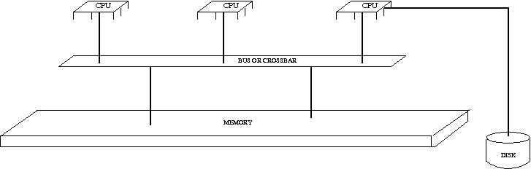
Multi-Processor Scheduling
Asymmetric multiprocessing
A single processor (master) handles all the scheduling with regard to CPU, I/O for all the processors in the system.
Other processors execute only user code.
only one processor accesses the system data structures, alleviating the need for data sharing
Symmetric multiprocessing (SMP)
Two or more identical processors are connected to a single shared main memory.
Most common multiprocessor systems today use an SMP architecture
Each processor does his own self-scheduling.

Slide 38
Issues with SMP scheduling - 1
Processor affinity
Migration of a process from one processor to another is costly
cached data is invalidated
Avoid migration of one process from one processor to another.
Hard affinity: Assign a processor to a particular process and do not allow it to migrate.
Soft affinity: The OS tries to keep a process running on the same processor as much as possible.
http://www.linuxjournal.com/article/6799

Slide 39
Issues with SMP scheduling - 2
Load balancing
All processors should keep an eye on their load with respect to the load of other processors
Processes should migrate from loaded processors to idle ones.
Push migration: The busy processor tries to unload some of its processes
Pull migration: The idle process tries to grab processes from other processors
Push and pull migration can run concurrently
Load balancing conflicts with processor affinity.
Space sharing
Try to run threads from the same process on different CPUs simultaneously

Slide 40

Real-Time Scheduling
Hard real-time systems
System must always complete a critical task within a guaranteed amount of time
On-board computer system of a robot
Designers must describe task requirements
Worst-case execution time of instruction sequences
“Prove” system response time

Slide 41
Real-Time Scheduling
Soft real-time systems
requires that critical processes receive priority over less fortunate ones

Slide 42
On-line demo
http://sehitoglu.web.tr/scheddemo/

Slide 43
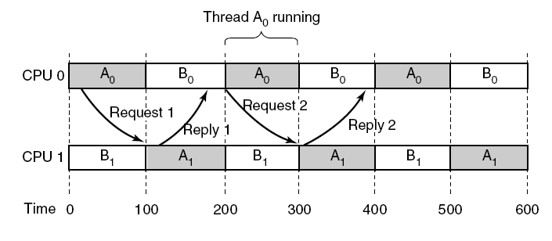
Gang Scheduling (1)
Communication between two threads belonging to thread A that are running out of phase.
Groups of related threads are scheduled as a unit, a gang
All members of a gang run simultaneously on different timeshared CPUs
All gang members start and end their time slices together
Tanenbaum, Modern Operating Systems 3 e, (c) 2008 Prentice-Hall, Inc. All rights reserved. 0-13-6006639

Slide 44
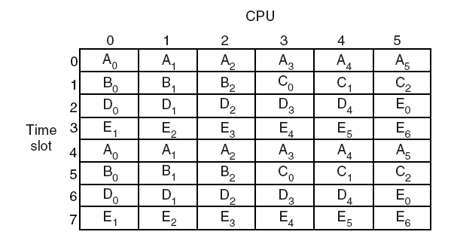
Gang Scheduling (2)
Tanenbaum, Modern Operating Systems 3 e, (c) 2008 Prentice-Hall, Inc. All rights reserved. 0-13-6006639

Slide 45
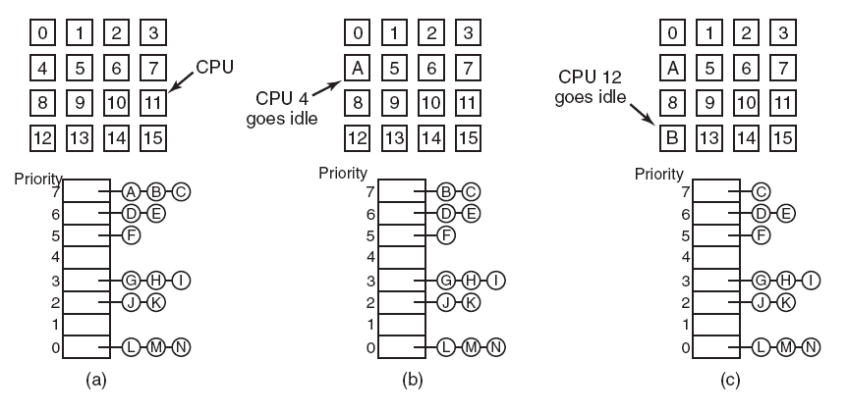
Timesharing
Scheduling independent threads
Have a single system-wide data structure for ready threads
Either as a single list
Or as a set of lists with different priorities
Automatic load balancing
Affinity scheduling

Slide 46
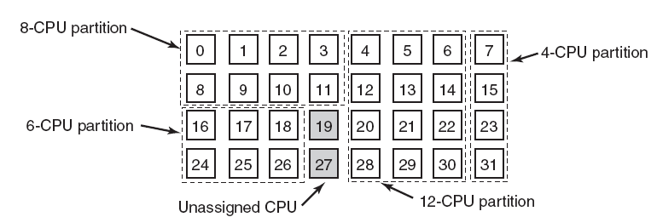
Space Sharing
Scheduling multiple threads that depend on each other at the same time across multiple CPU’s
Partition the set of CPUs into groups
Run each process in that particular partition
Can use one CPU per thread, eliminating context switches
Wastes CPU power when the thread goes for I/O

